Slide 1
Group 7 What are our Clothes Made From?
Enya Byrne/ Caitlin Loughran /Niamh Gillespie
Content:
Consequences of Climate Change
Impact of Textiles
Creating a Different Future

Slide 2
Group 7 -Overview
Lesson 1 | Lesson One: Understanding sustainable and Unsustainable materials Learning Objective: Understand the problems with unsustainable materials in clothing production, and solutions to this. Learning Outcomes: Understand that companies can use some materials, which causes harm to the earth. Discover problems caused using some materials. Understand how sustainable materials can be better for the earth. This lesson links to the twelfth Sustainable Development Goal: Responsible consumption and Production. | Activity One 'What is happening in these photos?' And 'how do these photos make you feel?’. Appendix one Then show images form appendix two and ask Do you recognise these brands? Activity Three- lets find out more Give the pupils clippings from articles about Nike and its use of materials. provide written print outs about sustainable materials that could be used as an alternative to these unsustainable materials. The pupils have the option to research articles using the links provided on ipads, in order to find out more information about Nike's use of unsustainable materials. Activity Three- from research findings complete a table of problems and solutions | A3 pages​/ Markers​/ Ipads/ Article Clippings Photos- Appendix 1 Photos Appendix 2 – www.ethicalconsumer.org/company-profile/nike-inc\ //goodonyou.eco/how-ethical-is nike/ https://www.bbc.co.uk/bitesize/articles/zdrw47h
Lesson 2 | Lesson Two: Experimenting with Natural Dyes Learning Objective: Understand how natural dyes can be used and how their effectiveness differs. Learning Outcomes: Justify Opinion Develop New Understanding/Investigate Products Evaluate Effectiveness | 1. Discuss the pupil’s favourite item of clothing, and have them justify this opinion.2. Provide age-appropriate facts to explain how fabrics are dyed. Discuss the fact that some foods can be used to make natural dyes.3. Ask the pupil what items they think would be able to dye clothing. Show them the examples of products that can create natural dyes.4.Model using a product to create a natural dye/paint. Allow the pupils to experiment in groups by using the range of products to create natural dyes and evaluate the effectiveness of the items.5. Give out print outs that provide instructions on how to dye clothes. Main Task Put the chosen substance in a bowl and add some water. Stir in the substance or crush it and then stir to help extract the colour. When the water has changed colour use a paint brush to paint it onto a piece of paper. | Prior to Lesson Send out letters to parents to confirm that there are no unknown allergies. Test out planned products to ensure they work. Gather all resources for the lesson. Group 7 Lesson 2 Appendix Two Safety Measures Check all allergies .Ensure children wash hands before and after. Clear Tables Piece of coloured clothing/ Paper/Blueberries /Tea Bags/ Strawberries / Bowls / Spinach Red Cabbage /Black Beans/ Ground Turmeric /Onion Skins /Carrots /Paint Brushes Utensils to grind and mix/ Water or access to/ Art t-shirts

Slide 3
Group 7 -Overview
 | Objectives and Outcomes | Learning Activities | Resources
Lesson 3 | Lesson Three: Designing a sustainable outfit for Nike and promoting it on social media. Learning objective Apply an understanding of what sustainable fashion is Learning outcomes Pupils should be able to: Discuss what sustainable fashion is Apply this knowledge through sketching Justify their outfit deign | Pupils will have a discussion in groups of 5/6 pupils. This will have a focus on what they have learned from past 2 lessons, such as the different materials and natural dyes that can be used in making. Pupils from each of the groups will then feedback to the class. As this is happening the teacher would create a mind map on the whiteboard of their ideas. For the main part of the lesson the pupils will return to their tables where they will find images of Nike clothing alongside samples of sustainable fabric. The pupils will then be given a template to design and promote their own outfit, for the brand Nike. They should apply their knowledge and dye samples from previous lessons to sketch this outfit on an Instagram template. | interactive white board, colouring pencils, pencils, Instagram templates, Nike images (to be used as contextual images), Dye samples from the previous lessons and fabric samples Group 7 Lesson 3 Appendix Three

Slide 4
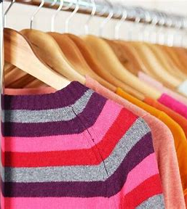
What are our Clothes Made From?
The 'What are Clothes Made from?' section of the Ten Tonne Challenge covers many aspects of sustainable development. It involves:
How different fabrics are made
If materials of sustainable or unsustainable
Natural and synthetic materials
Fabrics of the future

Slide 5
For all of these lessons there is a central theme of exploring sustainability within fashion.
We decided to have a focus upon Sustainable Development Goal 12.

Slide 6
Lessons
Understanding unsustainable materials and sustainable materials.
Experimenting with Natural Dyes
Apply an understanding of what sustainable fashion is

Slide 7
Lesson One: Understanding sustainable and Unsustainable materials
Learning Objective:
Understand the problems with unsustainable materials in clothing production, and solutions to this.
Learning Outcomes:
Understand that companies can use some materials, which causes harm to the earth.
Discover problems caused by the use of some materials.
Understand how sustainable materials can be better for the earth.
This lesson links to the twelfth Sustainable Development Goal: Responsible consumption and Production.
Resources needed:​
A3 pages​
Markers​
Ipads
Article Clippings

Slide 8
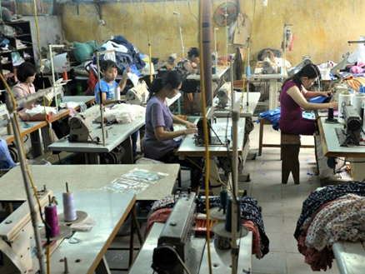
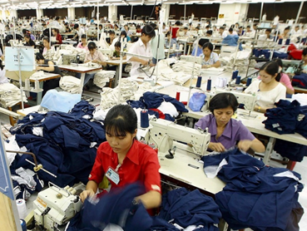
Lesson 1 Appendix 1
What is happening in these photos?’
And
‘How do these photos make you feel?'.

Slide 9
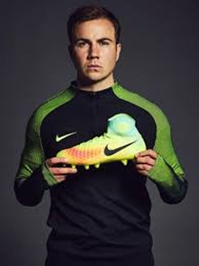
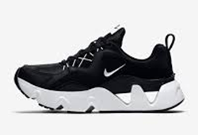
Lesson 1 Appendix 2 – Do you recognise these brands?
Notes:
Next, I would show these photos and ask the pupils if they recognise this brand. I would ask if they own clothes from this brand. I would then explain that the first photos show how these Nike products are made. Often, we do not know how companies make their clothes and how kind they are to the earth, and many big fashion companies can cause a lot of harm to the environment.
I would briefly introduce different materials and how they can be described as unsustainable. Define sustainability as the ability to use the world's natural resources in a way that won't harm the future of the planet. I would explain that many companies overuse materials that can cause harm to the earth, they can cause pollution in the oceans and it can use too much of a material, so that it is in danger of running out. Therefore, clothing companies need to adapt the materials they use so that they cause less harm to the earth, and are therefore more sustainable. For example, if plastic is overused, it can end up getting thrown out into the ocean, which will harm the wildlife and pollute the water. This is why it is so important for companies to make sustainable choices.
I chose to start the lesson with a hook to engage the students from the beginning, and to relate the lesson to a brand that they are familiar with, therefore placing the lesson in a context that the pupils are familiar with. The use of questioning aids formative assessment from the beginning of the lesson, and would allow me to gauge the level of understanding that the students have in this area. I have included higher order questions, in accordance with Bloom's Taxonomy, which encourages the pupils to explain their answer and to consider their emotions. Black and William (2001) support this use of assessment, they state that effective assessment aids the learning or all pupils.

Slide 10
Nike uses leather as a substantial part of its business. The leather industry uses harmful chemicals to preserve leather.
Nike retails several products containing animal-based materials, including leather, wool and feathers.
It takes almost 3,000 litres of water to make one cotton t-shirt.
Greenpeace criticises Nike’s use of hazardous chemicals and polluting waters.
Nike uses polyester and is yet to address the issues of microfiber plastic from textiles polluting the ocean.
https://www.ethicalconsumer.org/company-profile/nike-inc\
https://goodonyou.eco/how-ethical-is-nike/ https://www.bbc.co.uk/bitesize/articles/zdrw47h
Notes:
After the introduction, I would give the pupils clippings from articles about Nike and its use of materials. I would also provide written print outs about sustainable materials that could be used as an alternative to these unsustainable materials. The pupils have the option to research articles using the links provided on ipads, in order to find out more information about Nike's use of unsustainable materials.

Slide 11
Problems | Solutions
Nike uses leather, which uses harmful chemicals. | Nike could use ‘desserto’ instead, a plant-based leather made from a cactus.
Nike uses polyester, which pollutes the ocean. | Nike could use recycled plastic to avoid it getting dumped into the ocean.
Nike uses regular cotton, which takes 3000 litres to make one cotton shirt | Nike can use more organic cotton, as it uses less water than regular cotton.
Notes:
In mixed ability groups, the students can stick the article clippings, which explain the problems of Nike's use of materials on an A3 table. They can write more sustainable alternative to these problems that Nike could use, in the solutions column. More confident students can write their findings on the ipad into the relevant column.
I would model an example to the pupils on the whiteboard to explain how to do this. I would provide them with the first problem and solution, so that they understand what to do. Then, each group can present to another group in their class, and the teams can note down any new ideas that they have learnt.
I have scaffolded a lot of the lesson, so that the pupils can achieve the learning outcomes, while it is still age appropriate for year four. The pupils are in mixed ability groups, so that the lower attaining pupils can still be involved in the whole class learning. I have planned for differentiation, as lower attaining pupils will be able to stick the article clippings onto the table and they do not have to stress about the writing aspect of the lesson. The higher attaining pupils have the option to research more about the subject themselves on the ipad. This aids enquiry based learning, and allows the pupils to be active builders of knowledge. Sousa and Tomlinson (2011) support this type of differentiation, they state that a teacher's role is not to simply cover the curriculum, but adapt their teaching to maximise student learning.
When the pupils have the opportunity for group work and to share their work with their peers, this allows them to take pride in their work and reflects Piaget's social construction of knowledge. Furthermore, Vygotsky’s constructivist theory (cited in Pritchard and Woollard, 2018) supports the use of group work and presentations, as his theory states that language is key to all development.
As my lesson was first, I wanted to ensure that I had consolidated learning and that the pupils were familiar with the concept of unsustainable and sustainable materials, so that in later lessons they could become creative with the ideas.

Slide 12
Lesson Two: Experimenting with Natural Dyes
Learning Objective
Understand how natural dyes can be used and how their effectiveness differs.
Learning Outcomes
Justify Opinion
Develop New Understanding
Investigate Products
Evaluate Effectiveness
Lesson Outline
Discuss the pupil’s favourite item of clothing, and have them justify this opinion.
Provide age-appropriate facts to explain how fabrics are dyed.
Discuss the fact that some foods can be used to make natural dyes.
Ask the pupil what items they think would be able to dye clothing.
Show them the examples of products that can create natural dyes.
Model using a product to create a natural dye/paint.
Allow the pupils to experiment in groups by using the range of products to create natural dyes and evaluate the effectiveness of the items.
Give out print outs that provide instructions on how to dye clothes.

Slide 13
Piece of coloured clothing
Blueberries
Tea Bags
Red Cabbage
Black Beans
Ground Turmeric
Onion Skins
Spinach
Strawberries
Carrots Paint Brushes
Bowls
Utensils to grind and mix.
Paper
Water or access to.
Art t-shirts
Resources
Prior to Lesson
Send out letters to parents to confirm that there are no unknown allergies.
Test out planned products to ensure they work.
Gather all resources for the lesson.
Safety Measures
Check all allergies.
Ensure children wash hands before and after.
Clear Tables

Slide 14
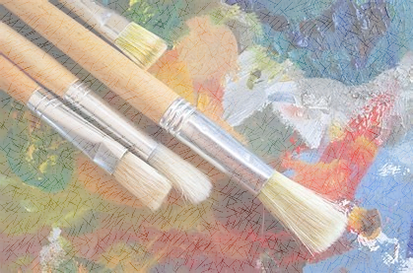
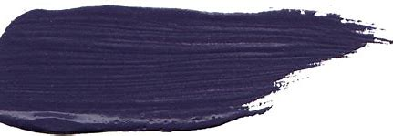
Main Task
Put the chosen substance in a bowl and add some water.
Stir in the substance or crush it and then stir to help extract the colour.
When the water has changed colour use a paint brush to paint it onto a piece of paper.
Food Used | Sample of Dye | Effectiveness (?/10)
e.g. Blueberries |  | 7/10
Notes:
For the lesson’s main task I wanted to make it experimental and let the children have a sense of control. I decided to base my lesson around an enquiry based approach to learning. I chose this approach is it allows the children to actively learn rather than through a passive process, (Austin et al., 2020). This approach to learning is found to increase pupil interest and motivation, providing them with a sense of ownership over their learning. This activity will be completed in groups to allow the children to participate in interactive exchanges that push them to broaden and deepen their understanding. As a group they will have to work together to great their sample but then discuss their opinions and come to an agreement on the effectiveness of the food as a dye. Due to the group approach to this task it also promotes collaborative learning which is found to help build positive peer relationships and further social, psychological and cognitive development, (PPDS, ND). To allow for differentiation I decided to use an open table format which does not require large amounts of writing and does not specify a number samples to be gathered. For those who are able to work at a faster speed they can had more and can even go into detail about why they gave their effectiveness rating. I would also consider, depending on the range of ability, mixing up ability groups so that the children can push each other and learn from each other. Grouping children with peers more or less able than them can help develop growth mindsets and higher self-efficiency, (Mohammad, ND). This lesson is a creative task that allows the children to really investigate how different items within their kitchen can be used to create natural dyes. This not only allows them to create more natural, sustainable dyes for clothes but also shows them how items can be reused rather than just thrown away.

Slide 15
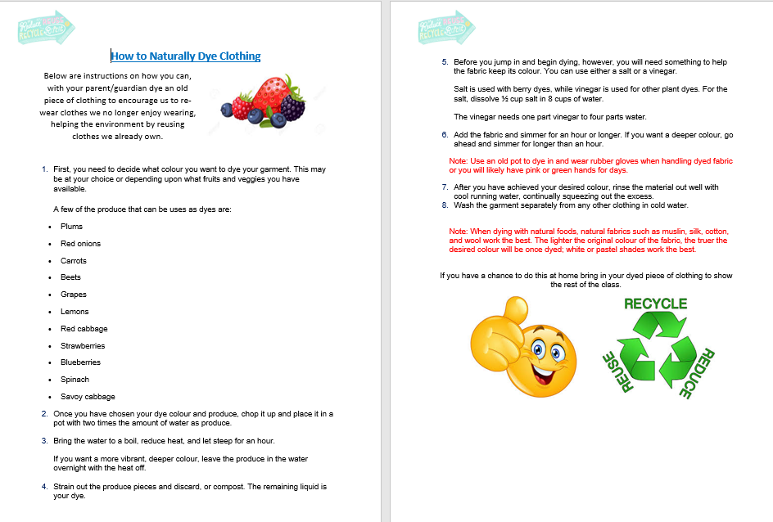
Group 7 Lesson 2 Appendix Two

Slide 16
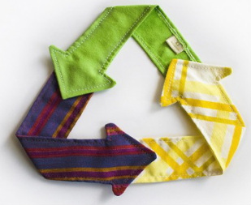
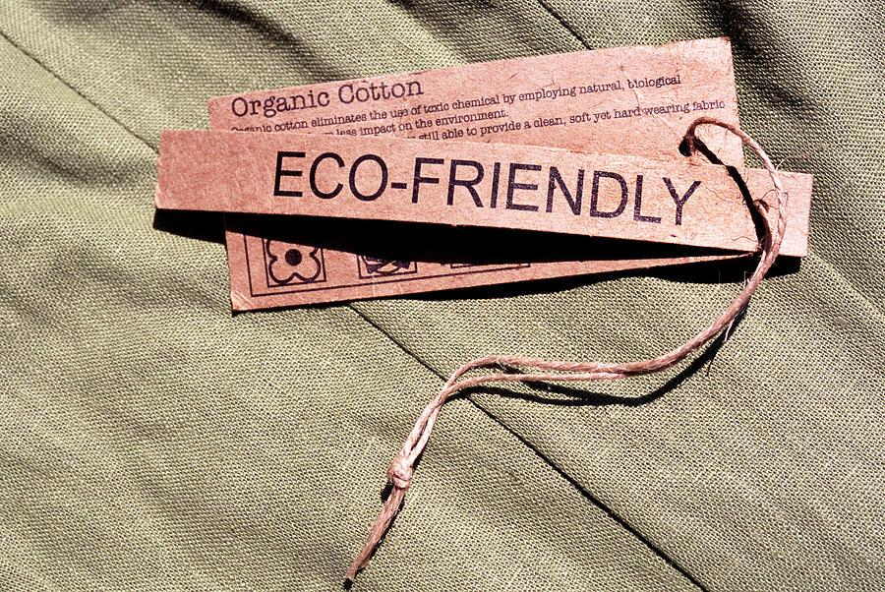
Lesson Three: Designing a sustainable outfit for Nike and promoting it on social media.
Learning objective
Apply an understanding of what sustainable fashion is
Learning outcomes
Pupils should be able to:
Discuss what sustainable fashion is
Apply this knowledge through sketching
Justify their outfit deign
Notes:
My lesson follows on from the previous two lessons, focusing on the children applying the knowledge that they have learned into creating an outfit or pair of trainers for the fashion brand Nike. I thought that using Nike would be suitable as it a brand that they have already looked at in Lesson 1 and that they may wear in their everyday lives. The Learning outcomes that I chose are specifically chosen to meet the learning objective.

Slide 17
Instagram template
Interactive whiteboard
Pencils
Resources needed
Nike images
Fabric samples
Colouring pencils
Dye samples
Notes:
The resources needed for the lesson I planned are the interactive white board, colouring pencils, pencils, Instagram templates, Nike images (to be used as contextual images), Dye samples from the previous lessons and fabric samples. Majority of these materials are easily accessible for a teacher to have in the classroom.

Slide 18
Outline of lesson 3:
To begin the lesson the pupils will have a discussion in groups of 5/6 pupils. This will have a focus on what they have learned from past 2 lessons, such as the different materials and natural dyes that can be used in making. Pupils from each of the groups will then feedback to the class. As this is happening the teacher would create a mind map on the whiteboard of their ideas.
For the main part of the lesson the pupils will return to their tables where they will find images of Nike clothing alongside samples of sustainable fabric. The pupils will then be given a template to design and promote their own outfit, for the brand Nike. They should apply their knowledge and dye samples from previous lessons to sketch this outfit on an Instagram template.

Slide 19
Group 7 Lesson 3 Appendix Three
Blank template
Scaffolded template
Notes:
. There are two types of Instagram template for the pupils to use in order to differentiate for lower and higher attainers.

