Slide 1

LWC Aims for this session
To increase awareness of the impact of modern day slavery/ trafficking / low wage economies on peoples lives
To explore the impact of the fashion industry on workers both in the UK and abroad
To explore the possibilities for integrating this focus into the school curriculum.
To review the possibilities of using the SDGs to explore issues around sustainability , waste and climate change.

Slide 2
https://www.youtube.com/watch?v=7oTqMk6qSdo
https://www.youtube.com/watch?v=xL5BQP25Qgg
Inside the Leicester sweatshops accused of modern slavery
https://www.youtube.com/watch?v=oSIrkB7o0hY
Modern-day slavery’ revealed in UK garment factories
10,000 could be being kept in slave-like conditions in factories in Leicester
https://www.youtube.com/watch?v=oSHyRMpKaBs

Slide 3
Country Overshoot Day
A country’s overshoot day is the date on which the Earth Overshoot Day would fall if all humanity consumed like the humans in this country.
Not all countries have an overshoot day. A country will only have an overshoot day if the Ecological Footprint per person is greater than global biocapacity (1.63 global hectares). Countries whose Ecological Footprint per person are less than the global biocapacity (1.63 global hectares) do not have an overshoot day, so they are not included in the graph.

Slide 4
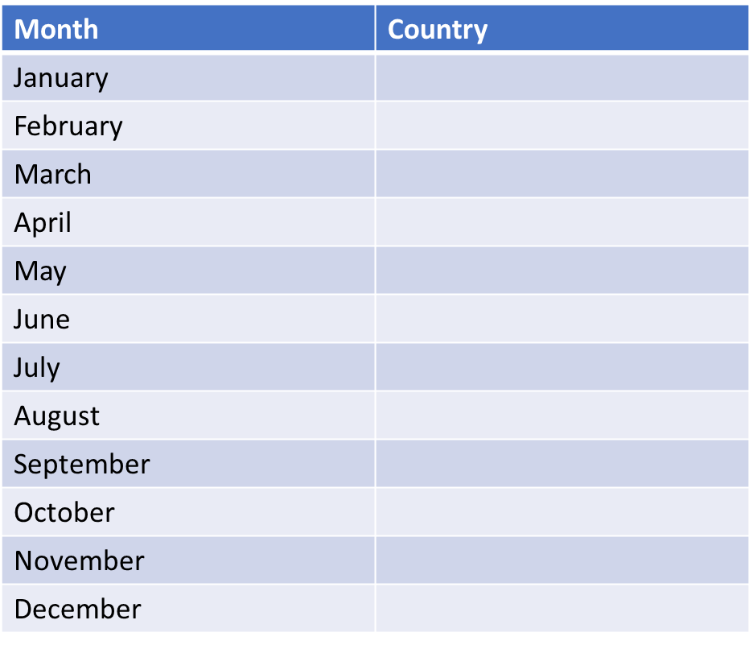
Let’s have a go in Breakout rooms
Can you put the following countries into the right months?
USA, Russia, China, Iraq, Qatar, UK, Indonesia,
Romania, Peru,
Vietnam,
Egypt,
Cuba, Iraq , Bolivia
Costa Rica,
The Geo History Textbook

Slide 5

The Geo History Textbook
Month | Country
January
February | Qatar
March | USA,
April | Russia,
May | UK,
June | China,
July | Romania, Bolivia
August | Costa Rica,
September | Peru,
October | Vietnam,
November | Egypt,
December | Iraq, Indonesia, Cuba
Can you put the following countries into the right months?
USA, Russia, China, Iraq, Qatar, UK, Indonesia,
Romania, Peru,
Vietnam,
Egypt,
Cuba, Iraq , Bolivia
Costa Rica,

Slide 6
Look at the graph then complete the activities.
Find the date of your country’s Overshoot Day.
Find the country whose Overshoot Day is the earliest in the year, and the country whose Overshoot Day lands on the latest date.
Search online for the economic and political reasons that could explain both cases.
Compare your own lifestyle with that of the inhabitants of the country in which the Overshoot Day lands nearest to December 31.
How could you change your lifestyle so that your country’s Overshoot Day would land after the currently estimated date?

Slide 7
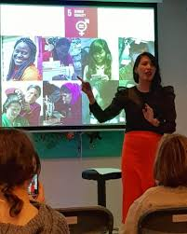

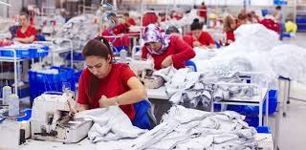
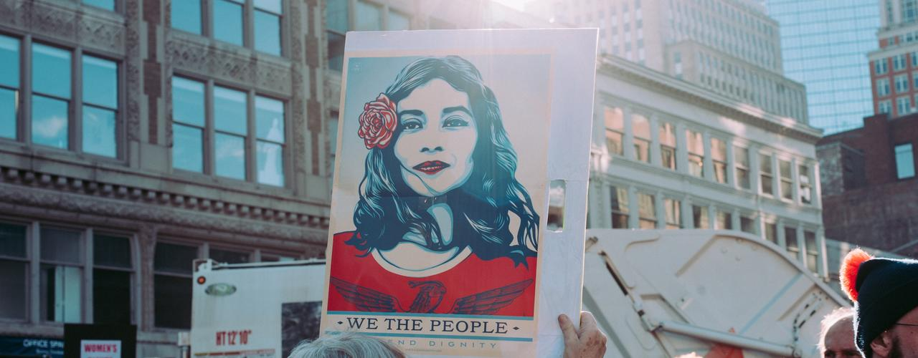
What's in an image ?
Notes:
https://www.notjustalabel.com/editorial/united-nations-sustainable-development-goals-why-fashion-matters

Slide 8
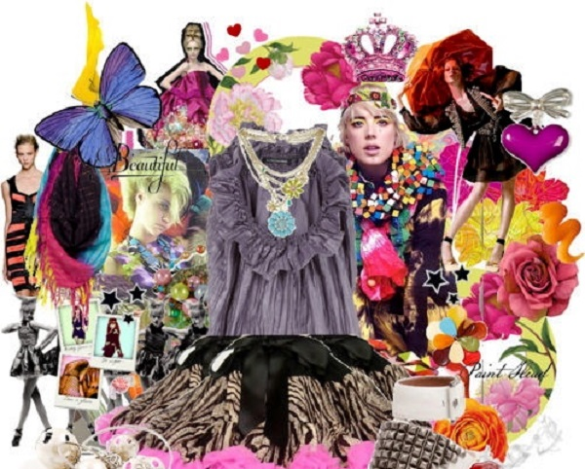
Quick Question: How many million garment makers are there in the world?
How many of these are women? How many are young woman?
Notes:
https://www.notjustalabel.com/editorial/united-nations-sustainable-development-goals-why-fashion-matters

Slide 9
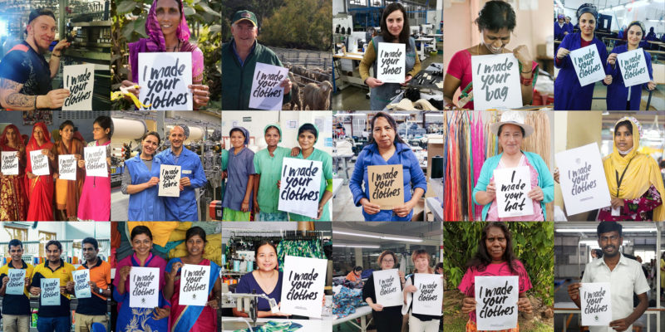
How could you use this image as a lesson starter?
Notes:
https://www.notjustalabel.com/editorial/united-nations-sustainable-development-goals-why-fashion-matters

Slide 10
Declaration of Human Rights
On December 10, 1948 the General Assembly of the United Nations adopted and proclaimed the Universal Declaration of Human Rights (UDHR).
1948
It states that:
Everyone has a right to…

Slide 11
life, freedom and security
humane treatment
6
equal protection in law
freedom of thought, conscience and religion
rest and leisure
Section 1 The Declaration
take part in government
access public service and social security
marry and start a family
own property
be presumed innocent
until proven guilty
Work, for a just wage
an adequate standard of living
Freedom of opinion
and expression
free choice of employment
just conditions at work
freedom of peaceful
assembly and association
join a trade union
protection of privacy, family, home, correspondence and reputation
education
asylum from persecution
participate in
cultural life
a nationality
Notes:
Teachers’ notes
Display the slide, using the animation.
Ask: Do you think it is important that the UDHR was proclaimed? Why/why not? (Draw out that, in order for people to defend their rights they first need to know what their rights are).
Give time for students to read the completed screen.
Ask for examples of people in the UK who experience infringement of their human rights.
Millions of people in the world experience life-threatening infringements of their human rights. Where do you think the majority of these people live? Why might this be? What conditions are necessary in a country or area for human rights to be consistently upheld?
Alternatively, you could use the following video to introduce the Declaration: http://www.youtube.com/watch?v=hTlrSYbCbHE
(CAFOD is not responsible for the content of external websites)
Optional extra activity:
Make a display illustrating the Universal Declaration of Human Rights using pictures from newspapers and magazines.

Slide 12
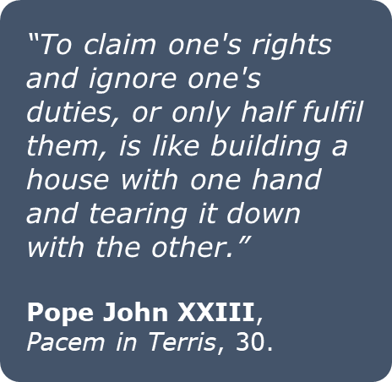
Rights lead to duties
UDHR, Article 29, states that:
“Everyone has duties to the community in which alone the free and full development of his or her personality is possible.”

Slide 13

Using the SDGs to explore the fashion Industry
1. Which of the SDGs link to the UN statement ‘ leaving no one behind’?
2. How does the problem of modern day slavery make it hard for the global goals to be achieved in the UK, the EU or the world?

Slide 14
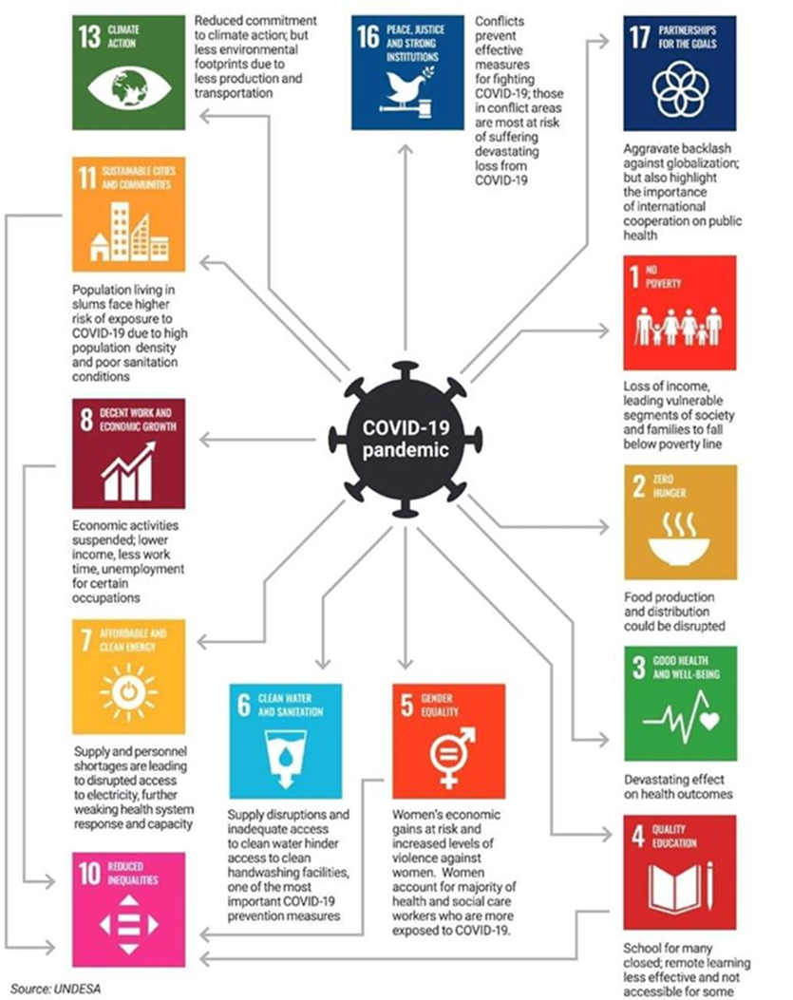
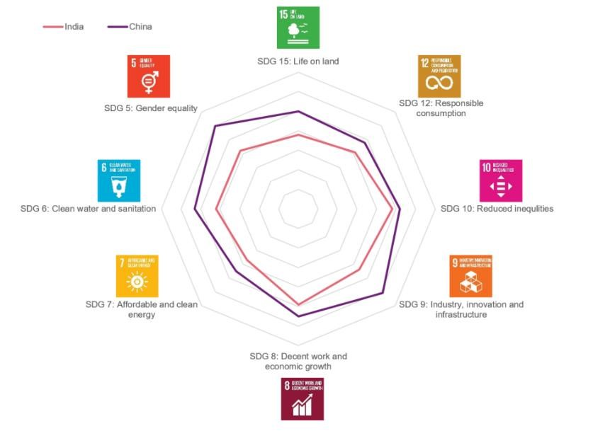
Using the SDGs to explore the fashion Industry

Slide 15



SUSTAINABLE DEVELOPMENT GOAL 5
5.1: End all forms of discrimination against all women and girls everywhere
5.2: Eliminate all forms of violence against all women and girls in the public and private spheres, including trafficking and sexual and other types of exploitation
5.3: Eliminate all harmful practices, such as child, early and forced marriage and female genital mutilation
Notes:
signs.

Slide 16
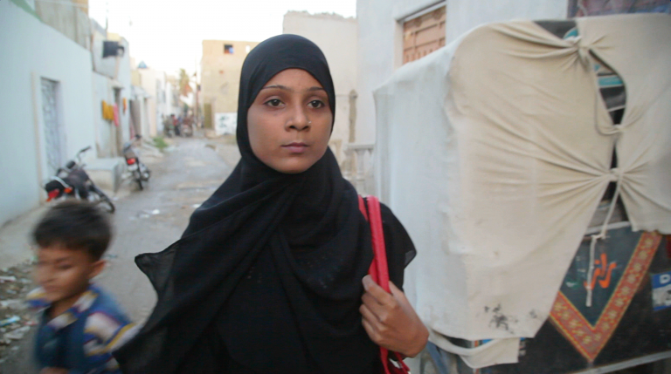
What Does Gender Equality Have To Do With the Fashion Industry? Everything.
60 million people around the world are garment workers, and 80% of that number is made up of young women ages 18-24–the same demographic as the millennial women who consume Teen Vogue.
https://remake.world/stories/news/how-the-united-nations-sdgs-relate-to-the-fashion-industry/
Tell Her Story with Dignity
https://remake.world/stories/news/what-does-gender-equality-have-to-do-with-the-fashion-industry-everything/

Slide 17

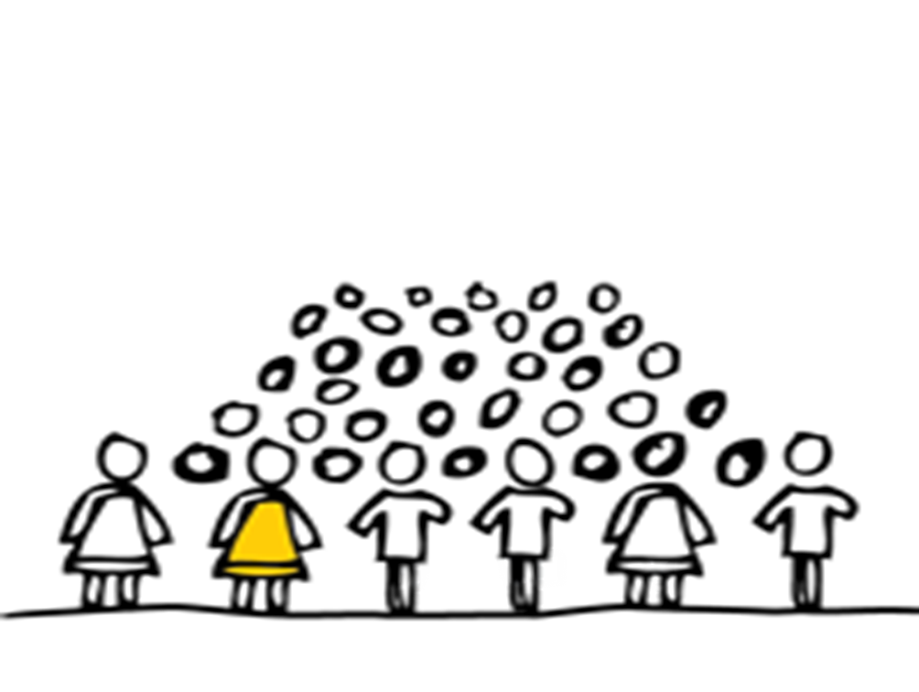

UNICEF estimates that 1.2 million children are trafficked every year

Slide 18


Modern Day Slavery
How would your pupils feel seeing these posters in their community?

Slide 19

What is the point of this charity creating this poster? How do they want people in communities to think and act?
What Do You see? Anti Slavery Clip
https://www.youtube.com/watch?v=fcGRPAfuqIo&app=desktop

Slide 20
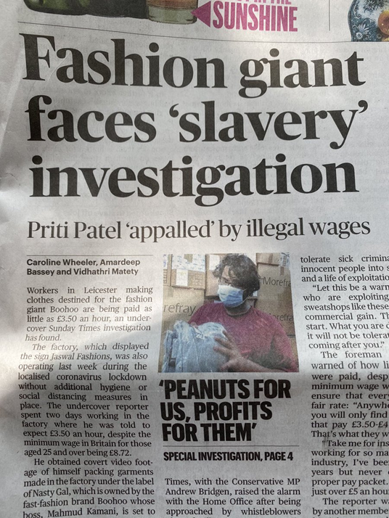
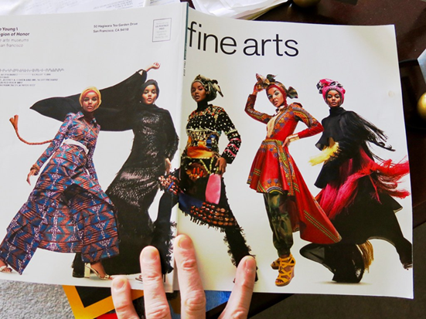
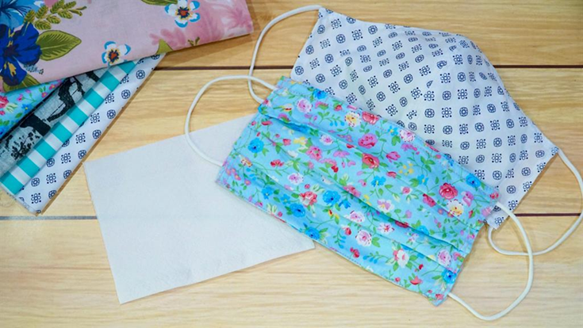
‘ Leaving no one behind- the dark figures of modern day slavery’ We see. We act.
Inside the Leicester sweatshops accused of modern slavery
https://www.youtube.com/watch?v=xL5BQP25Qgg
Inside the Leicester sweatshops accused of modern slavery

Slide 21
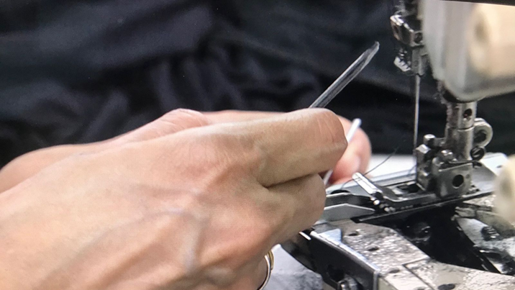
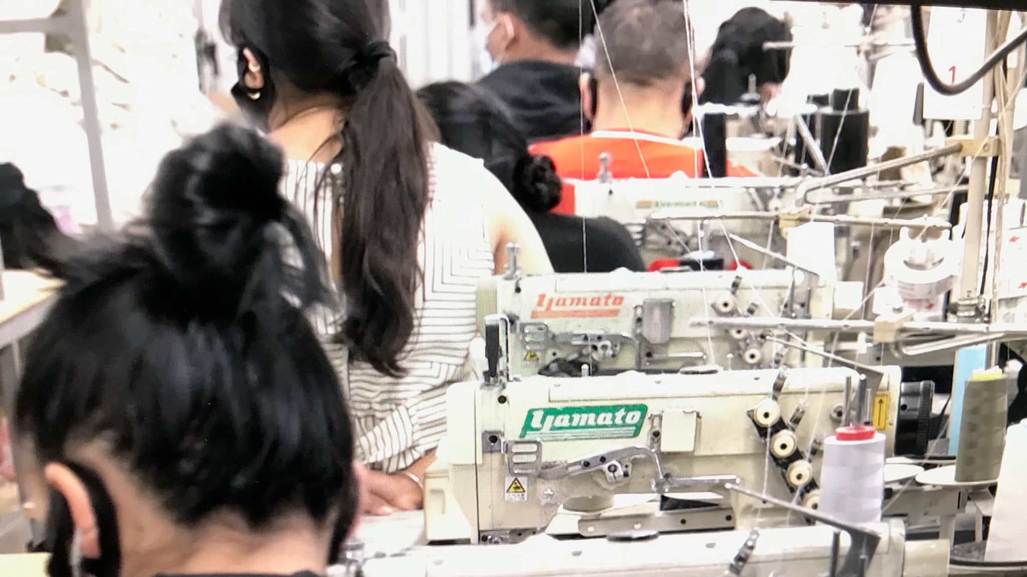

Slide 22
LITERACY
Poems, stories, writing
PSHE
Where could you integrate this project?
HUMANITIES
Locations, economic work ,
SMSC
What moral issues are there linked to this theme?
SCIENCE
developing new , sustainable ideas
BRITISH VALUES
CITIZENSHIP
Where could you bring in active citizenship
Student Action
‘ Leaving no one behind- the dark figures of modern day slavery’
We see. We act.

Slide 23


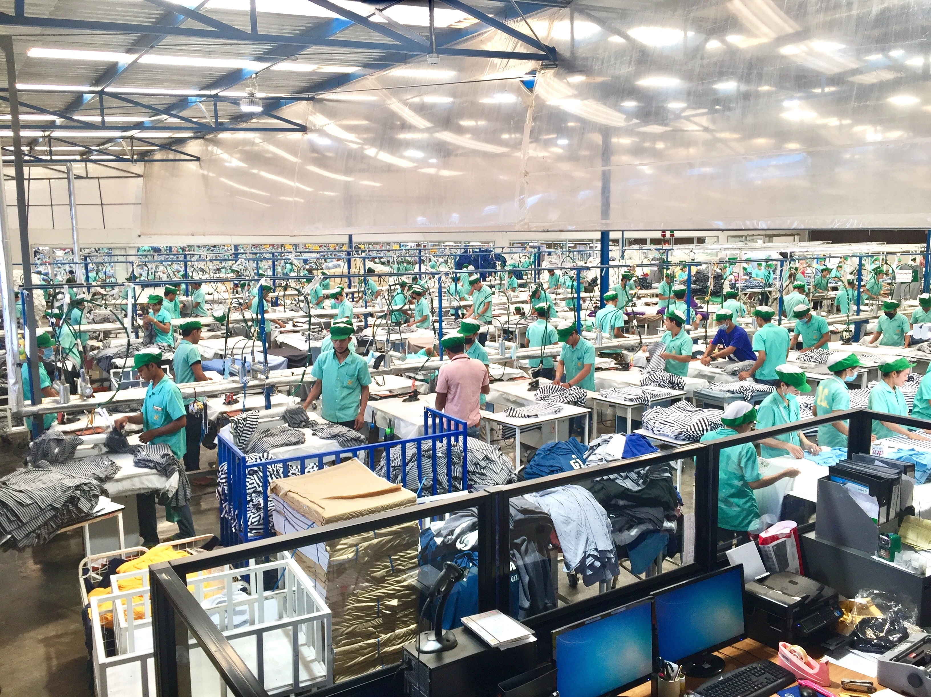
Identify - what can you see? Where might it be? (1-2)
Describe – what do you think is happening? (3-4)
Explain – why do you think this is happening? (5)
Apply – is this occurring in other places – why might this be? (6-7)
Link – what are the impacts of this on the country where people came from? (8-9)

Slide 24
Active Learning
Images | Creative responses Poems , plays and stories | Writing letters to MPs
Opinion Lines | Case studies | Developing Blogs
Role Play | Balloon Debate | Creating an assembly
Diary writing | Flip Chart presentations | Inviting speakers

Slide 25
Give Students A Choice
Generic Choice Board | Generic History Source Choice Board.
Create a mind map explaining key elements described/observed from the information you have and show how they connect. | Image Sources Only. Describe the image in exactly 100 words. | Develop 3 quiz questions and answers using the source/ information . You will share these with another student.
Select five important points from the information you have been given and list them in order of importance. | Written Sources only. Design a detailed image, which depicts the key message of the source. Label key features. | Write a script turning the information into a section of a play. Who would be speaking, what they say, what impact would this have.
AIM HIGH: Pay close attention to the spelling of key terms.

Slide 26
Engaging Student Learning
Activity Two: Would you use any of these activities with your pupils when teaching on this focus?
Making Connections Help students link the past to the present and make real-life connections Give students a theme from current affairs and/or ask them to develop their own. How does the reading relate today? | Collaborative Note-Taking - Make full use of online resources, simple one is Google Doc, create a table and assign learners into different groups. Each group needs to consider a category such as key individuals, themes or significant events from the text. Students can see each others work in real time.
Random Partner Pairings Use a name generator to pair up students. https://www.classtools.net/random-name-picker/ They read the selected text together and they complete a collaborative task. Answering questions, creating a graphic organizer, or prepare a mini presentation. | Bring reading to life -Before reading, share a relevant song, video clips, artefact other material that coincides with the information. - Encourage students to find out more and ask them to find new connecting material.

Slide 27
Active Citizenship
Challenge
How could you get your pupils to develop a campaign on the theme of waste and fast fashion?

Slide 28

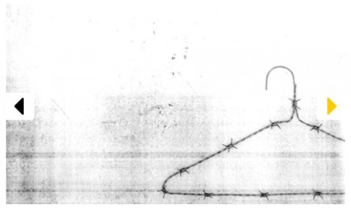


What You Can Do?
“The industry’s textile production has a bigger carbon footprint than all international flights and shipping combined. ”

Slide 29
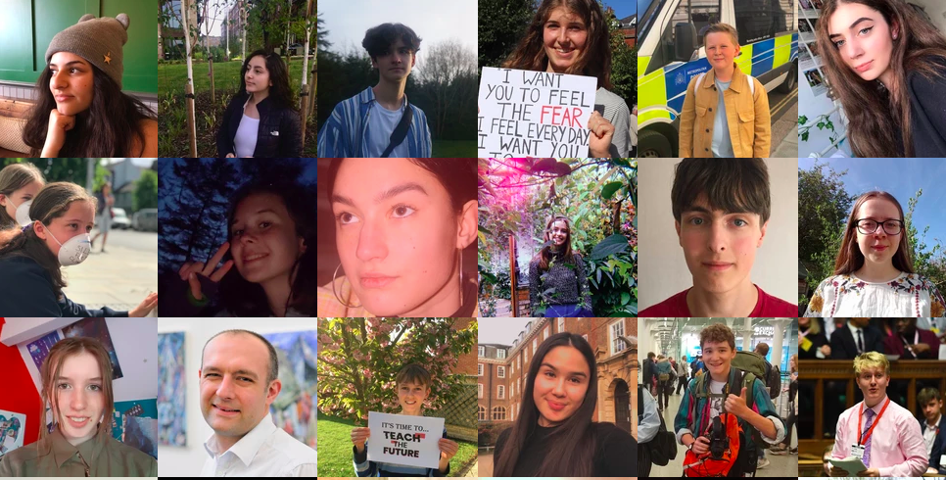
What You Can Do?
This is an organisation for young students who want to be actively campaigning on climate change
https://www.teachthefuture.uk
/

Slide 30
SDG 5: Achieve gender equality and empower all women and girls
End all forms of discrimination against all women and girls everywhere.
Eliminate all forms of violence against all women and girls in the public and private spheres, including trafficking and sexual and other types of exploitation.
Ensure women’s full and effective participation and equal opportunities for leadership at all levels of decision making in political, economic and public life.
Ensure universal access to sexual and reproductive health and reproductive rights
Undertake reforms to give women equal rights to economic resources, as well as access to ownership and control over land and other forms of property, financial services, inheritance and natural resources, in accordance with national laws.
Enhance the use of enabling technology, in particular information and communications technology, to promote the empowerment of women.
Adopt and strengthen sound policies and enforceable legislation for the promotion of gender equality and the empowerment of all women and girls at all levels.

